Slide 1
Artificial Intelligence: provoking a debate on the financing of social insurance (SI)
Peter S Heller
Williams College
November 10, 2017

Slide 2
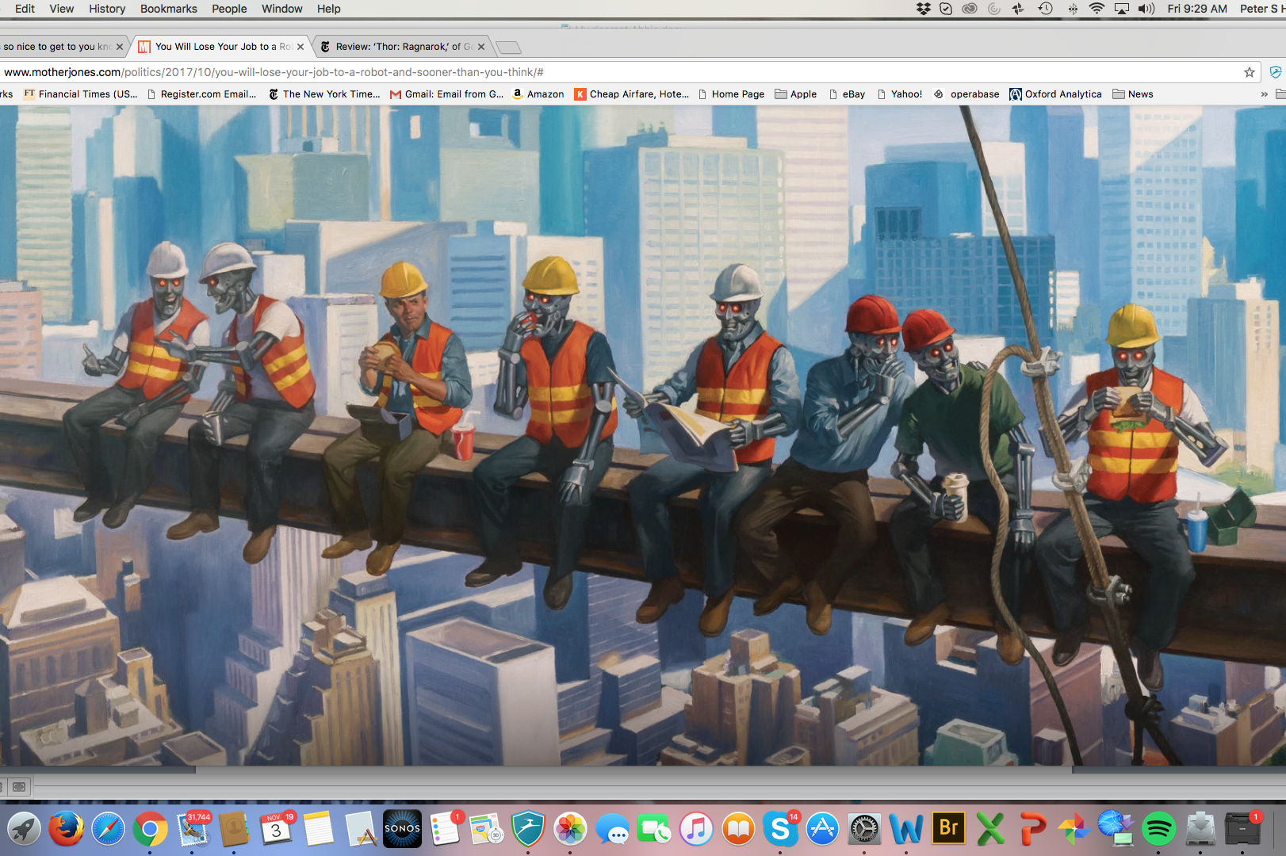

Slide 3
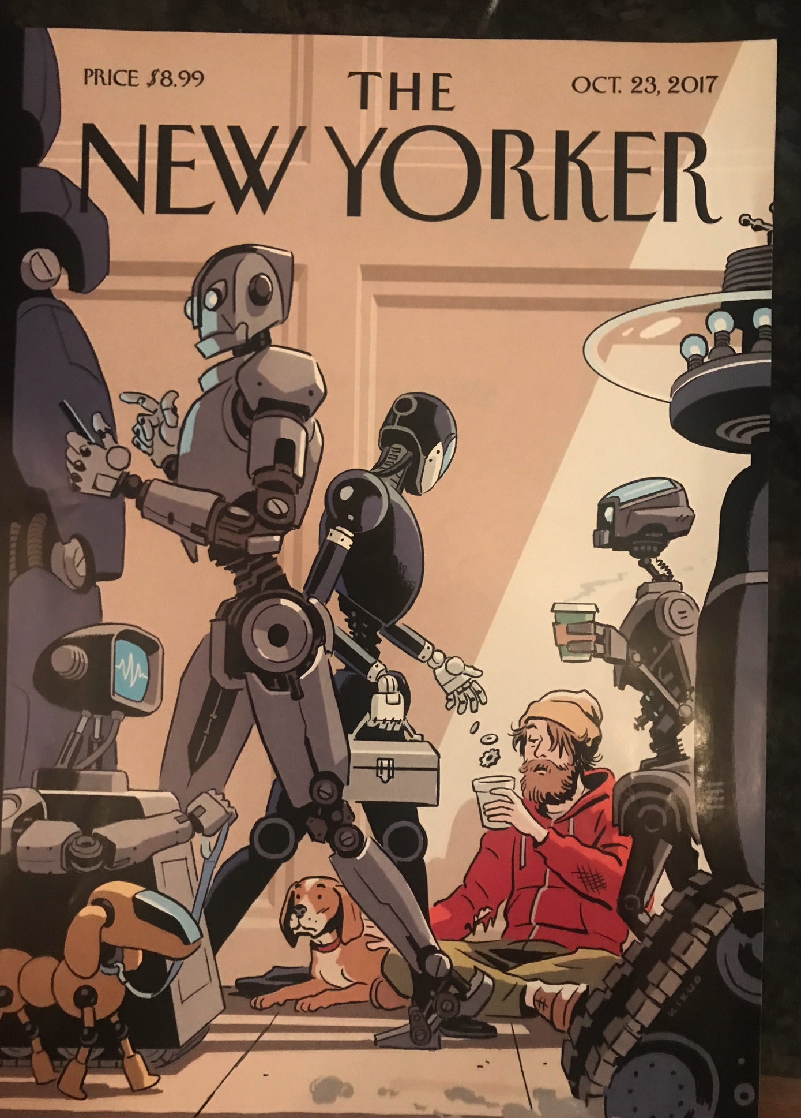

Slide 4
“The development of robotics and AI may result in a large part of the work now done by humans being taken over by robots so raising concerns about the future of employment and the viability of the social security system if the current basis of taxation is maintained, creating the potential for increased inequality in the distribution of wealth and influence.”
  EU Committee on Legal Affairs, Draft Report from the Working Group on Legal Questions Related to the Development of Robotics and Artificial Intelligence (may 31, 2016
“the likely impact of AI in the years ahead was still underappreciated by policy makers and by the public at large. They foresaw that AI would transform entire sectors of the economy and lead to in-depth societal changes. A recurrent issue was the need for public policy makers from governments and NGOs to understand and begin to prepare society for the changes afoot.”
OECD (Feb 10, 2017)

Slide 5
Focusing on Impact on SI
Reflects the dependence of SI systems dependent for their financing on payroll taxes. AI impact on employment may occur at the same time as the financing needs for social insurance explode because of rising share of elderly in the population. AI may also result in significant losses in income tax revenue to the general budget. May also create pressures for universal benefit grants
Issues:
  Will the financing base of SI implode?
  What alternative financing base for SI?
  Will unemployed lose eligibility for pension, disability, and health benefits under SI?
  What will be the consequences for the overall budget deficit?

Slide 6
Key questions
Will AI create significant unemployment? How large an impact would create important policy challenges for SI systems?
How soon until such effects become important?
  Within 5-10 years? Even if later, eventually?
  McKinsey (2/2017): will take time: 2 decades before automation reaches 50% of all of today’s work activities. (p. 3)

Slide 7
Key questions (continued)
For which economies will the effect be greatest? Even in middle income countries affected: 1/3 of robots shipped to MIC in 2015. For LICs and middle income countries, effect may be borne by workers on threshold of escaping poverty.
  ILO study (2016) on 5 ASEAN countries suggests significant potential job losses
Will disparities in ownership of AI algorithms/capacity adversely affect employment in some countries?
Should SI financing reforms begin to be phased in?
  Addressing current financial viability vs. long-term actuarial sustainability
  Linking benefit eligibility to employment contributions vs. citizen’s rights?
How to address the loss in revenue to the general budget from income tax revenue
Will AI create financing needs additional to SI, and what tax reforms will be necessary? Bears on issues of inequality

Slide 8
AI and unemployment?
Research offers different views on the magnitude and timing of any impact
Will jobs displaced be offset by new jobs?
  Normal technological churning of jobs being replaced vs. the horse
  Nature of disruption: prospects for retraining for new jobs or speed at which new opportunities for employment will be created?
  Regional differences as to where impact likely to be faced: some regions hit hard: “geographic clustering of the affected jobs—either directly or by imports)
  Share of the work force likely to be permanently displaced?
  Brian Arthur: determining access to production: ”who gets what and how they get it?”

Slide 9
Do current tax provisions encourage substitution of robots for labor?
Abbot and Bogenschneider (2017) note:
  Payroll tax encourages substitution of capital for labor
  Accelerated depreciation further reduces cost of robots and AI approaches relative to cost of labor

Slide 10
AI and its impact on income and wealth distribution
OECD study, which dampened concerns also notes that “low qualified workers likely to bear the brunt of the adjustment costs…the likely challenge for the future lies in coping with rising inequality and ensuring sufficient (re-)training especially for low qualified workers.

Slide 11
Does significant uncertainty argue for holding back on any tax reforms?
Tax reform not an overnight proposition
Would require recognition of quantitative significance of the impact of AI on SI-covered employment
If AI effects are inevitable over the long-run, argues for movement on tax reform
Will AI significantly increase the share of capital income in the economy?
Will it increase pretax inequality? Will this independently argue for tax reform?

Slide 12
What policy options?
Shift away from financing from payroll taxation and towards general budget financing
Restore tax neutrality by reducing preference for automation relative to labor and increase the share of taxes borne by capital derived from automation
Other ideas (Oberson (2017)
  Granting a legal personality to robots (independent of form) so as to create an electronic ability to pay recognizable for tax purposes
  Levy an income tax on the “imputed hypothetical salary the robots should receive from equivalent work done by humans”
  Impose a lump-sum tax representing an approximate ability to pay the tax: initially on the owners of robots
  Apply a VAT on robots’ activities
  Levy an automation tax, based on ratio of a company’s revenues (total sales) to their numbers of employees— the higher ratio of robots to sales, the higher the tax
  Recognize cross border issues: “proper application of tax treaty allocation rules and transfer pricing rules would likely have to be revisited.”

Slide 13
What policy options? (continued)
Increase taxation of capital income, particularly if there is an increase in the capital share in the income distribution?
A factor to consider in the debate on the focus of corporate tax reform: full expensing vs. lowered tax rates:
Encourage companies to invest in human capital
Support adjustment assistance efforts to facilitate transition from jobs coming under pressures
Taxation of digital-based businesses or services, raising important questions for corporate taxation: what to tax? Where to tax it? (currently raised by EU)
Will AI algorithms acquire ownership rights to assets?
  Taxation of income from AI-owned assets?
  Will AI algorithms own assets and have rights to contribute to political campaigns (analogous to corporations)?
  Will AI-owned units seek to strategically minimize their income tax liability?
Create a sovereign wealth fund on patents (Autor).

Slide 14
Other issues-1
Issue 1: should one narrowly focus on financial viability of SI schemes subject to loss in payroll tax revenue due to job loss OR larger issues associated with significant share of work force without income and with prospect of a need for some kind of universal basic income scheme?
  Raises the issue of the nature of social welfare or social insurance contract in the future and the appropriate sources of funding.
    determining eligibility for SI benefits?
    Determining the magnitude of benefits, e.g., for pensions
  If issue is more significant over time, need more comprehensive, sustainable designs
Issue 2: Employment impact of AI may differ substantially across individual countries and as between Advanced, Emerging Market and Low Income Countries.
  Note: much of the wealth associated with AI may derive from patented technologies owned by US and China.
  Possibility of intra-country fiscal redistributional mechanisms quite different from challenges faced by countries primarily suffering losses in fiscal revenue and smaller pie to redistribute

Slide 15
Other issues-2
Issue 3: Suggests importance of proposals for timely measurement and monitoring of pace and spread of AI technology
“Policy makers are flying blind into what has been called the fourth industrial revolution or the second machine age.” “At best, this paucity of information will lead to missed opportunities. At worst, it would be disastrous if we want to understand and prepare for and guide the unpredictable impacts of advancing technology.

Slide 16
References
Ryan Abbott and Bret Bogenschneider, “Should Robots Pay Taxes? Tax Policy in the Age of Automation,” Harvard Law and Policy Review , forthcoming (2017); https://papers.ssrn.com/sol3/papers.cfm?abstract_id=2932483
“Daron Acemoglu and Pascual Restrepo, “Robots and Jobs: Evidence from US Labor Markets,” NBER Working Paper Serires 23285 https://www.nber.org/papers/w23285)
Melanie Arntz, Terry Gregory and Ulrich Zierahn, “The Risk of Automation for Jobs in OECD Countries,” OECD Social Employment and Migration Working Papers No. 189 ( 2016) http://dx.doi.org/10.1787/5jlz9h56dvg7-en
Brian Arthur “Where is technology taking the economy? (McKinsey & Company, McKinsey Quarterly October 2017)
Andrew Berg, “Robots, Growth and Inequality,” Finance and Development, September 2016, pp 10-13.
Jacques Bughin, Susan Lund, and Jaana Remes, “Rethinking work in the digital age,” McKinsey Quarterly (October 2016)
Jae-Hee Chang and Phu Huynh, Asean in Transformation: The Future of Jobs at Risk of Automation, International Labor Organization (July 2016), http://www.ilo.org/public/english/dialogue/actemp/downloads/publications/2016/asean_in_transf_2016_r2_future.pdf
“Premature deindustrialization: Sew What now?” Economist magazine, Oct 7, 2017, pages 16-17)
European Commission “A Fair and Efficient tax system in the European Union for the Digital Single Market”
  EU Committee on Legal Affairs, Draft Report from the Working Group on Legal Questions Related to the Development of Robotics and Artificial Intelligence (may 31, 2016)
  Jack Ewing, “Robocalypse Now? Central Bankers Argue Whether Automation will Kill Jobs” NY Times June 28, 2017

Slide 17
References (continued)
C.B. Frey and M. A. Osborne (2013), The Future of Employment: How Susceptible are Jobs to Computerization>? University of Oxford
Robert Gordon The Ruse and Fall of American Growth, Princeton University Press (2016)
Kai-Fu Lee “The Real Threat of Artificial Intelligence,” New York Times, June 24,2017
McKinsey Global Institute, “Technology, Jobs and the Future of Work,” (February 2017) (prepared for the Fortune Vatican Forum, Dec 2016)
National Academies of Sciences, Engineering and Medicine,” Information Technology and the U.S. Workforce: Where are We and Where Do We Go from here? (2017) Executive Summary
Xavier Oberson, “How Taxing Robots could help bridge future revenue gaps,” (2017) http://www.oecd.org/employment/how-taxing-robots-could-help-bridge-future-revenue-gaps.htm
OECD “Summary of the CDEP Technology Foresight Review: Economic and Social Implications of Artificial Intelligence,” Feb 10, 2017
Ruchir Sharma, “No, that Robot will not steal your job” NY Times (october 7, 2017) https://www.nytimes.com/2017/10/07/opinion/sunday/no-that-robot-will-not-steal-your-job.html?_r=0
United States, Executive Office of the President, Artificial Intelligence, Automation and the Economy (2016)

